Slide 1
transacTions In Microservices
Designing without ACID guarantees

Slide 2

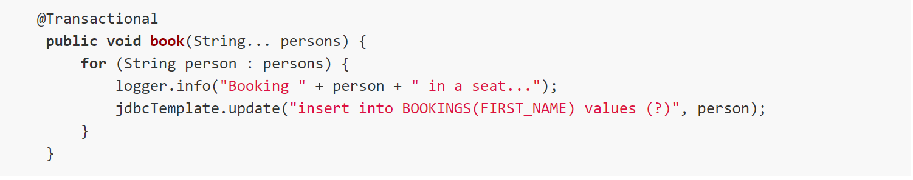

Monolith application using spring

Slide 3
Distributed transactions – DTP-2PC
Notes:
Commit request phase and commit phase. We want to use async messaging and loose coupling.

Slide 4
sagas
A sequence of local transactions
Notes:
Each step executes update in a local transaction
Emits message
Failure of local transition starts a revert of previous steps

Slide 5
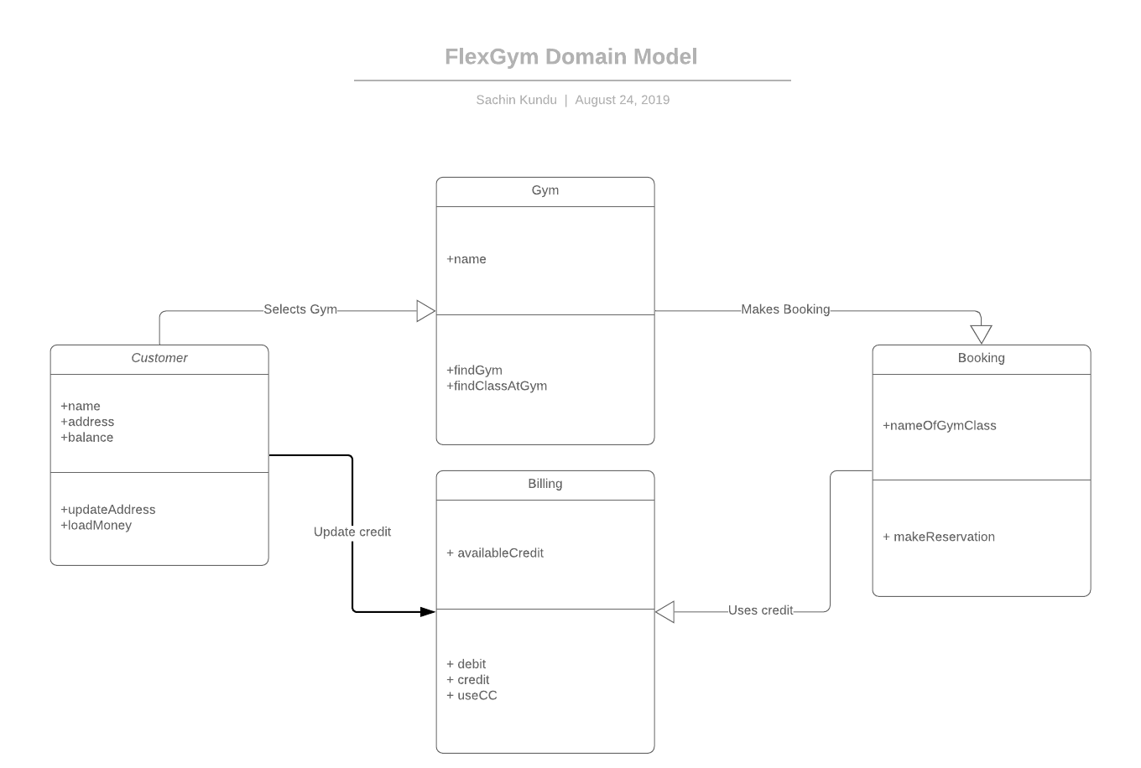

Slide 6
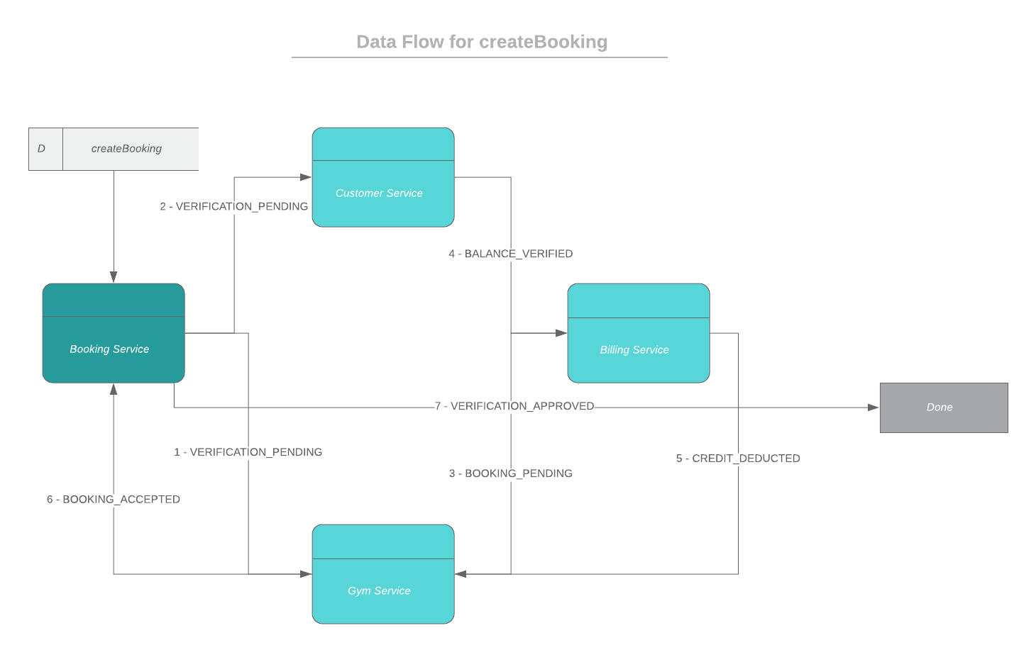
Notes:
Using async messages here makes us loosely coupled. Buffering and retries etc might be nicely provided by the messaging infrastructure.

Slide 7

Saga messaging patterns

Slide 8

choreography
Notes:
Simple and elegant. Works for smaller sagas. Might need lock step releases which is problematic for complex apps.

Slide 9

orchestration
Notes:
Central component which is a finite state machine. Do not put business logic into orchestrator.
This would be it for saga if everything just went according to plan but they do not and things ----

Slide 10

Compensating transactions
Notes:
Compensating transactions. Emit messages which leads to rollback of all steps previously executed.

Slide 11

Notes:
ACD is done but what about I ? Isolation? We cannot guarantee that. But we can work with and around it.
We don’t want two concurrent sagas to interfere with each other. Remember we do not have guaranteed message ordering.
We can use sematic locking and VERIFICATION_PENDING is one such method. Another saga is wary of using information from a saga in VERIFICATION_PENDING state.
Business critical steps can be run in 2PC and we make a conscious decision to do that. Safety over availability.

Slide 12
Code samples in C#
JAVA, I meant JAVA ;)

Slide 13


Sachin kundu sakundu@Microsoft.com https://github.com/microservices-patterns/ftgo-application

